Slide 1
Fruit Fly Larvae Investigation
SCoPE
Scientists’ Collaborative Project with Educators

Slide 2
Learning Objectives
SCoPE
To observe different levels of organisation within an organism, including cells, tissues, organs and organ systems.
To dissect fruit fly larvae and prepare a microscope slide.
To use an identification key to identify tissues and organs in the larvae.
To view the digestive system as an example of an organ system and to detect changes in pH in the intestine using an indicator dye and make parallels with the human digestive system.
To appreciate the use of fruit fly as model organisms.

Slide 3
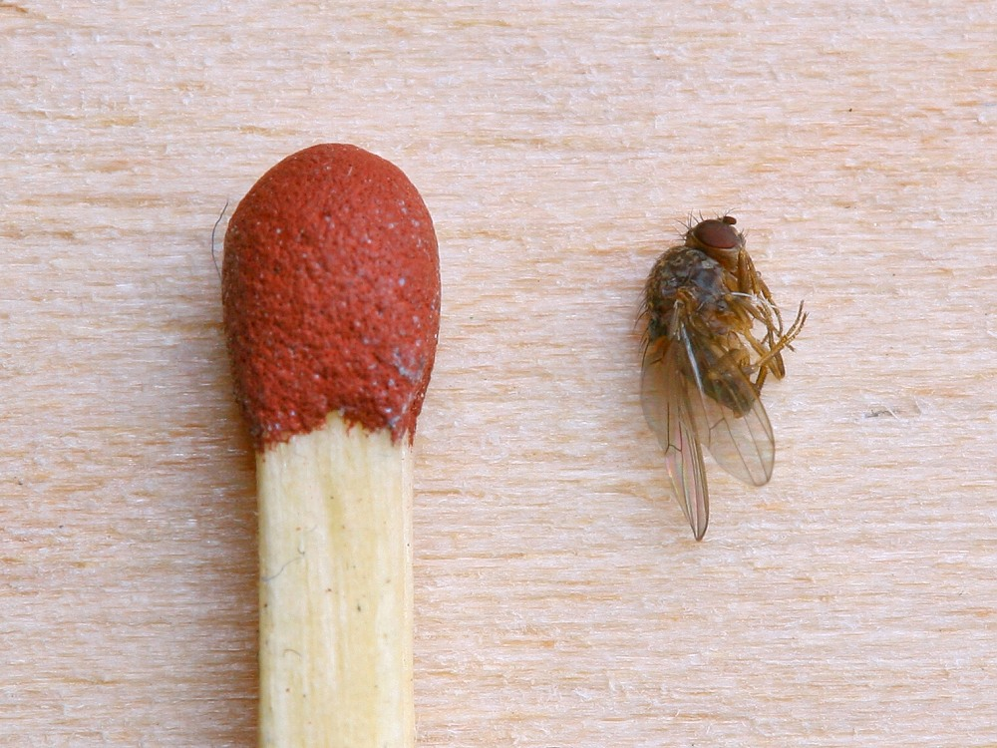
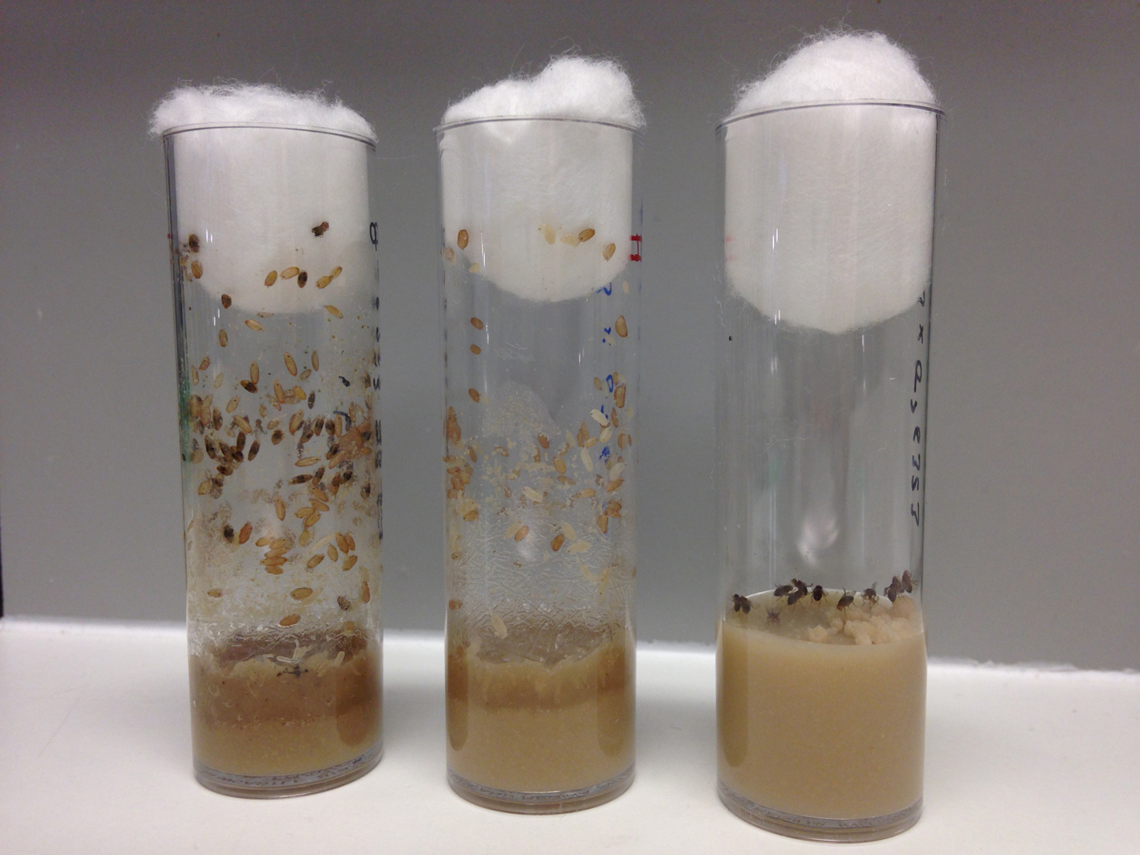
SCoPE
Drosophila are small, easy to handle
and inexpensive to feed
Match versus Drosophila
In the lab: Drosophila vials
Notes:
Fruit flies are known as Drosophila and are much smaller than normal house flies (about 3 mm long). You might have seen them around rotting or over-ripe fruit.
Images from: Photomacrography.net and Helene Doerflinger, St Johnston Lab, Gurdon Institute

Slide 4
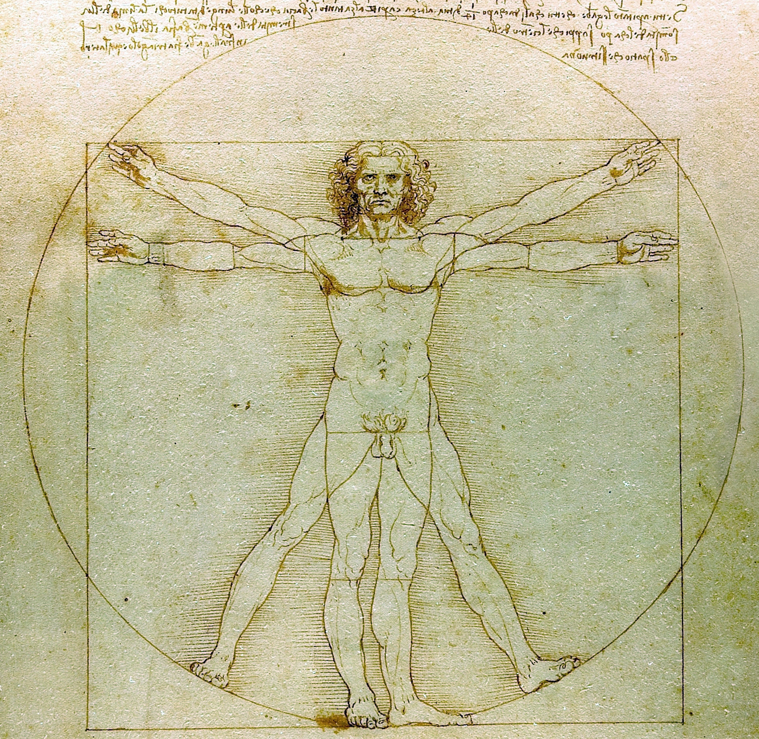
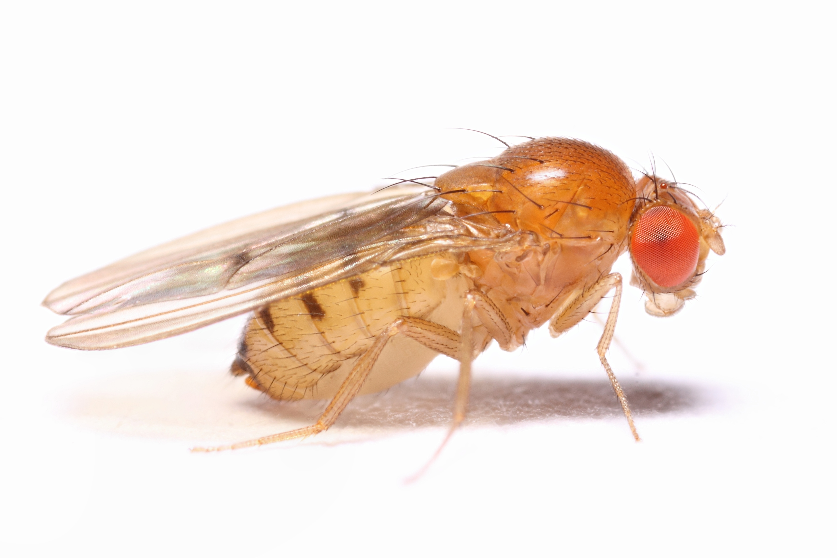
The fly: a powerful model
SCoPE
Humans and flies share about 70%
of the same disease-causing genes
Notes:
50% of fly protein sequences have mammalian homologues.
About 70% of known human disease genes have a recognizable match in the genome of fruit flies and 50% of fly protein sequences have mammalian homologs.
An online database called Homophila is available to search for human disease gene homologues in flies and vice versa.
Drosophila is being used as a genetic model for several human diseases including the neurodegenerative disorders Parkinson's, Huntington's, spinocerebellar ataxia and Alzheimer's disease.
The fly is also being used to study mechanisms underlying aging and oxidative stress, immunity, diabetes, and cancer, as well as drug abuse.
At the Gurdon Institute, scientists are using flies to understand brain development and disease (Brand Lab), mitochondrial DNA inheritance (Ma Lab) and polarity (how a cell knows which side is ‘up’ and which side is ‘down’, a mechanism that often gets confused in cancer) (St Johnston Lab).
For more details, check out gurdon.cam.ac.uk and read ‘our research’ sections on the Brand Lab, Ma Lab and St Johnston Lab.

Slide 5
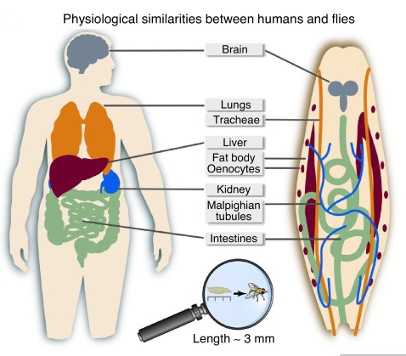
SCoPE
Humans and flies have many of the same organs
Notes:
Fly larvae share many physiological similarities with humans
Image from: Wang et al. 2018

Slide 6
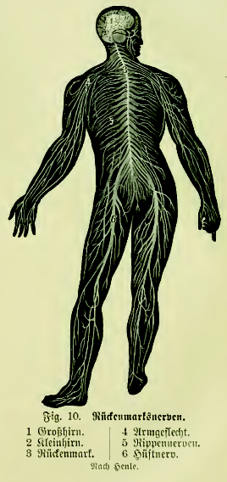
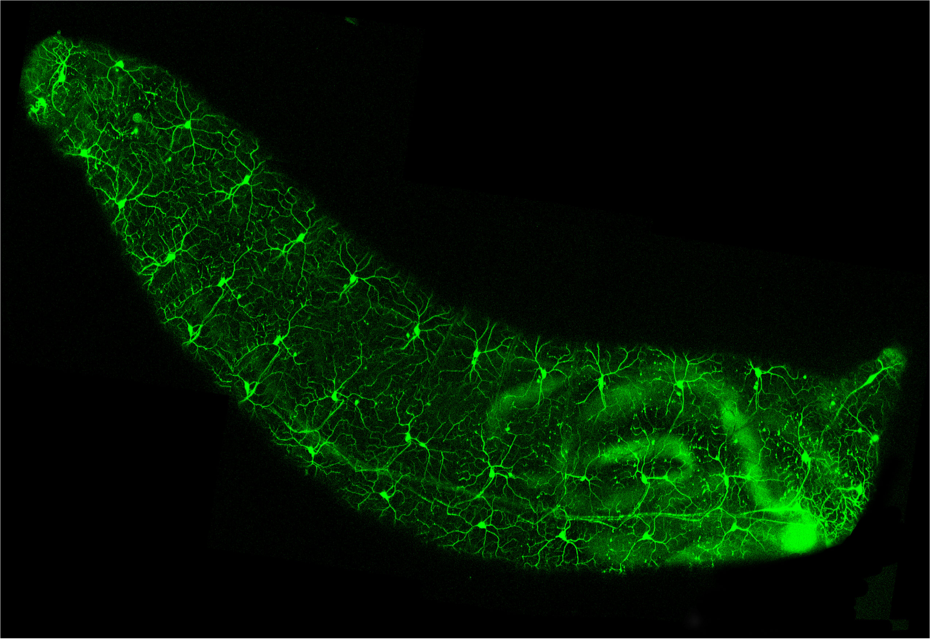
SCoPE
Humans and flies have many of the same organs
Nervous system
Human
Fly larvae
Notes:
Fly larvae also have a similar nervous system to humans.
Images from: Wikimedia Commons and the Brand Lab, Gurdon Institute

Slide 7
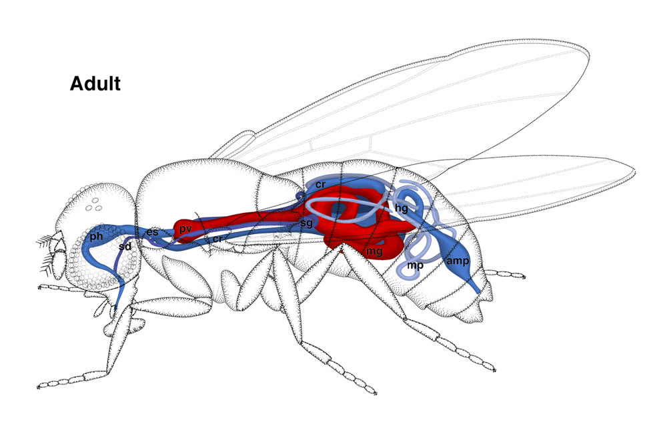
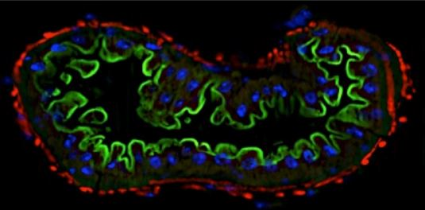
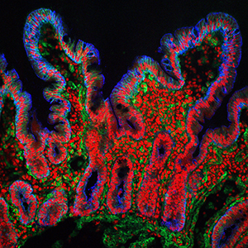
SCoPE
Humans and flies have many of the same organs
Digestive system
B Lemaitre
Notes:
The bottom images show cross-sections through intestines showing a villus and a crypt in humans (left) and microvilli (green) muscle (red) and nuclei (blue) in fly.
Both are highly folded tissues to maximise the surface area for absorbing nutrients.
Images from: Wikimedia Commons and the Quadram Institute and Bate & Martinez Arias (1993) and EPFL

Slide 8
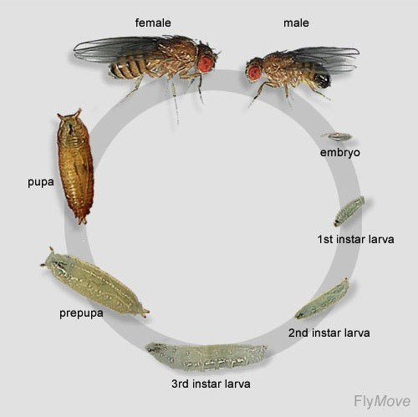
SCoPE
Short life cycle,
10 days at 25ºC
Notes:
Metamorphosis happens during pupae-adult stage. We are using fruit fly larvae (2nd or 3rd instar stages) for dissection.
For scientists studying genetics, the short life cycle is convenient so that the effects of a mutation transmitted to the next generation can be observed within a couple of weeks.
Image from: FlyMove

Slide 9
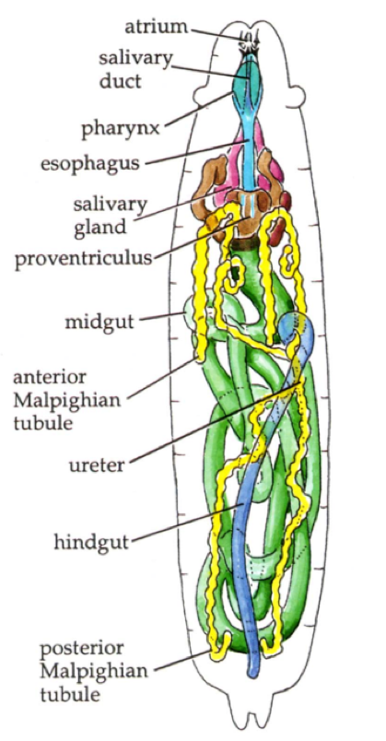
SCoPE
The mouth parts grab food which enters the atrium (mouth).
The salivary duct passes digestive enzymes and juices from the salivary gland.
The salivary glands are particularly large in the larva as its main activity is to eat, digest food and store the energy in the form of fat.
The intestine runs throughout the length of the body. Food passes from the atrium, through the esophagus (blue), midgut (green) and hindgut (blue) before being expelled.
Malpighian tubules serve similar function to kidneys in taking away waste products of metabolism.
Notes:
The larvae have organs which perform the essential functions of life. The larva has enzymes to digest carbohydrates, proteins and fats as well as the cells walls of bacteria and fungi.
Drosophila have an open circulatory system containing haemolymph (but not blood, as mammals have). The haemolymph is a fluid which contains nutrients.

Slide 10
Development of Larvae
SCoPE
Notes:
This slide shows which parts of the larva develop into the recognisable features of the adult fly.
The details of how fruit flies develop is the subject of many research projects which ultimately aim to understand how development happens in many organisms.

Slide 11
Equipment
SCoPE
Each team will receive:
a vial of fly larvae*
a clear plastic ruler
a microscope slide*
a plastic coverslip*
a magnifier*
two fine forceps*
an A5-size black plastic dissecting surface*
approximately 5 ml of saline
a fine tipped plastic Pasteur pipette*
a laminated 3-page identification key*
*provided by the Gurdon Institute
Notes:
These items are also listed on the student instructions.

Slide 12
Safety
SCoPE
The forceps have very fine points and are very sharp – please take care of them and put the cover back on when not in use.
The microscope slides are made of glass and could break. Please inform a teacher if any glass gets broken. We have a sharps bin for disposal of broken glass.
The larvae are provided growing on yeast. There are no particular hazards associated with the larvae but you should wash your hands at the end of the practical.
You may have a vial containing blue larvae. These have been grown on yeast containing bromophenol blue which is a pH indicator. It is yellow below pH 3, green between pH 3 and 4.6 and blue at pH 4.6 or above.

Slide 13
Method (see video on the next slide)
SCoPE
Place a microscope slide on the black plastic surface.
Add 1-2 drops of saline onto the middle of the slide.
Using the forceps, carefully pick out a larva from the side of the vial – choose one of the whitest and largest ones – and place it onto the liquid droplet on the slide.
Put the magnifier over the microscope slide and turn the light on.
With forceps in each hand, grasp the larva at each end and gently pull apart, teasing apart the internal structures.
Place a coverslip on top and view under the magnifier or microscope if, available.
larva
black plastic dissection surface
saline
slide
coverslip

Slide 14
Method - video
SCoPE

Slide 15
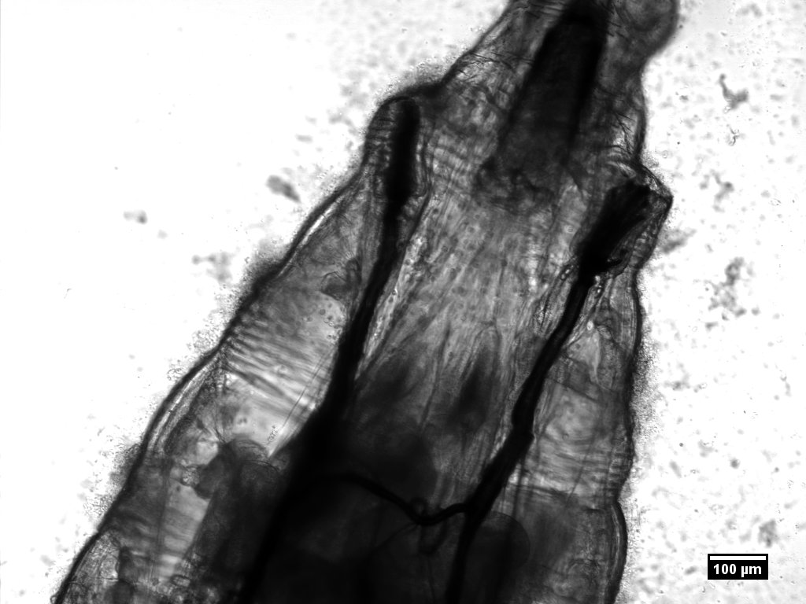
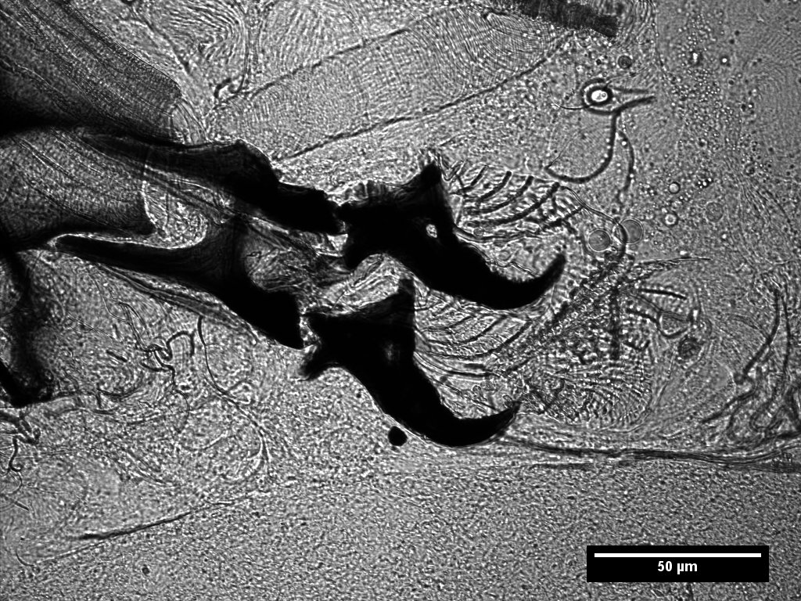
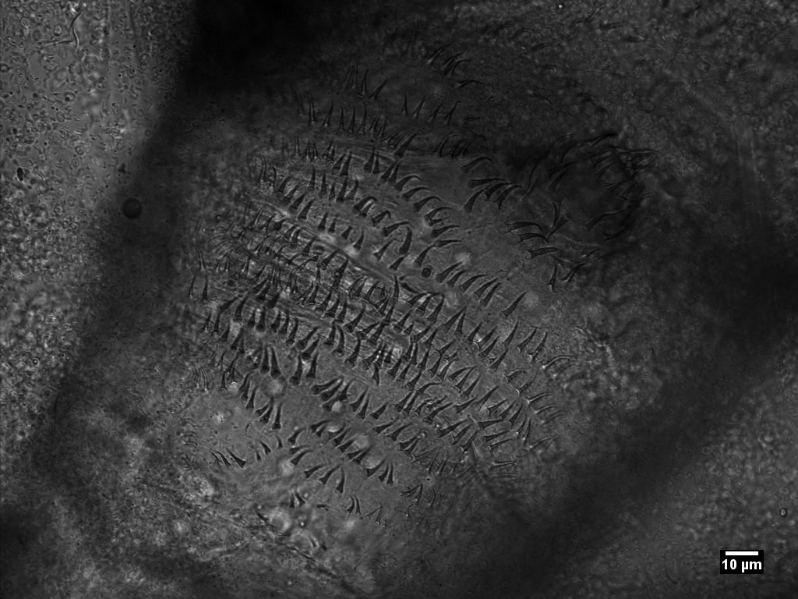
Before dissection, look at the cuticles and head part to see if you can spot these features:
SCoPE
spiracle
mouth hook
trachea
Oxygen is delivered to the tissues by trachea which go from the spiracles (holes on the external surface near the mouth) and branch into smaller and smaller tubes to reach into all parts of the body.
denticles

Slide 16
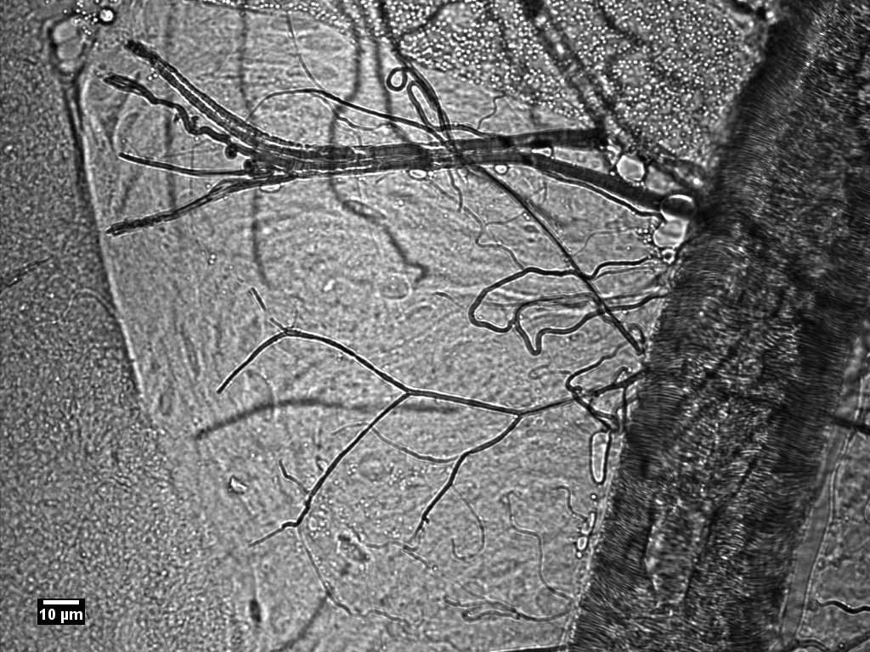
After dissection, you may be able to see…
SCoPE
fat
trachea
gut
Notes:
Trachea are lined with a layer of parallel fibres to stop them collapsing under pressure – they allow oxygen in the air to be passed through the body and then diffuse into the tissues.

Slide 17
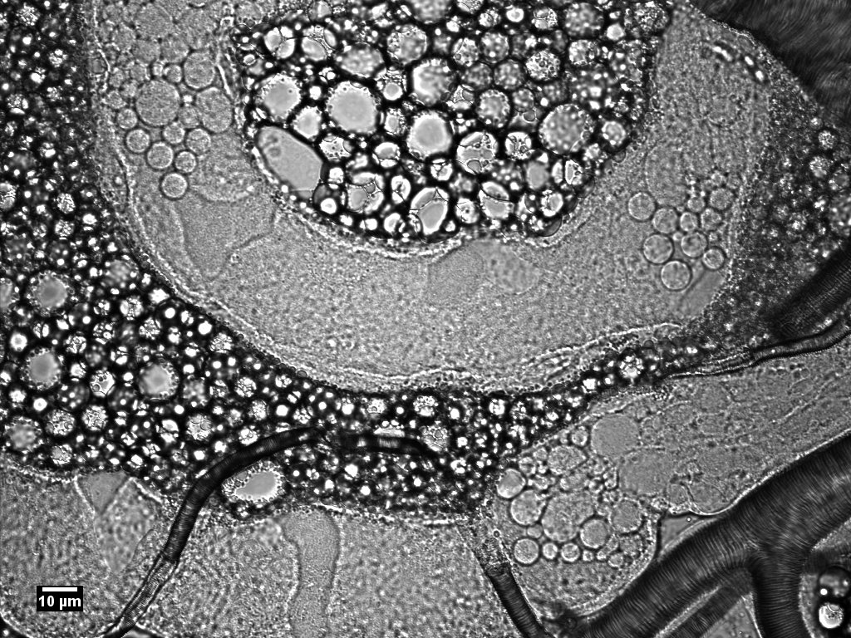
SCoPE
After dissection, you may be able to see…
fat cells
Malpighian tubule
trachea
Notes:
Trachea are lined with a layer of parallel fibres to stop them collapsing under pressure.

Slide 18
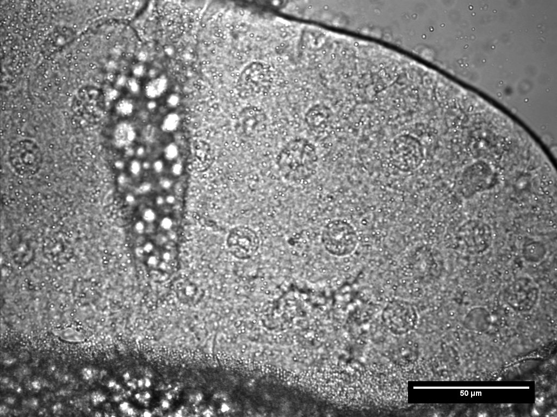
After dissection, you may be able to see…
SCoPE
Salivary gland
Salivary glands
fat
Salivary gland cell nucleus
Notes:
The salivary gland is relatively large compared to the body size of the larva. The cells are also relatively large and nuclei can be seen with a high-powered light microscope.
If the larvae have been stained with orcein then the nuclei are more easily visualised under a lower power microscope

Slide 19
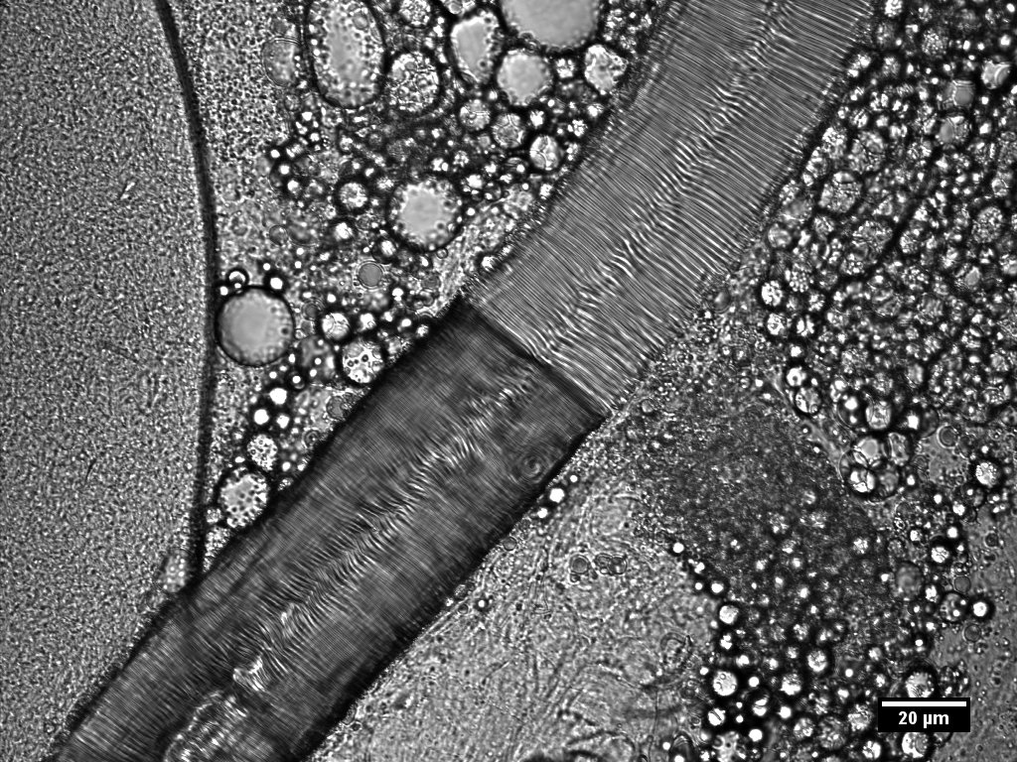
Tracheae
SCoPE
After dissection, you may be able to see…
Notes:
On the left, the branching of the tracheae can be seen. On the right a higher magnification image shows the banding of the trachea which performs a similar function to the cartilage in humans – i.e. keeping the airways open under fluctuating pressures.

Slide 20
Cleaning up
SCoPE
Put the used microscope slides and coverslips into the yellow bin provided.
Bring your vial of flies and all equipment to your teacher.
If your forceps had a tip cover, please replace it before returning them.
Wash your hands.

Slide 21
SCoPE
Debrief
What did you observe?
What structures were you able to identify?
Was the inside of the larva what you expected?
How do the cells in the larva get oxygen and glucose?
Compare and contrast the digestive system of the larva with that of humans.

